Slide 1
How to use olive oil
to make nice breakfast
class 97, #205, Daeseong Shin

Slide 2
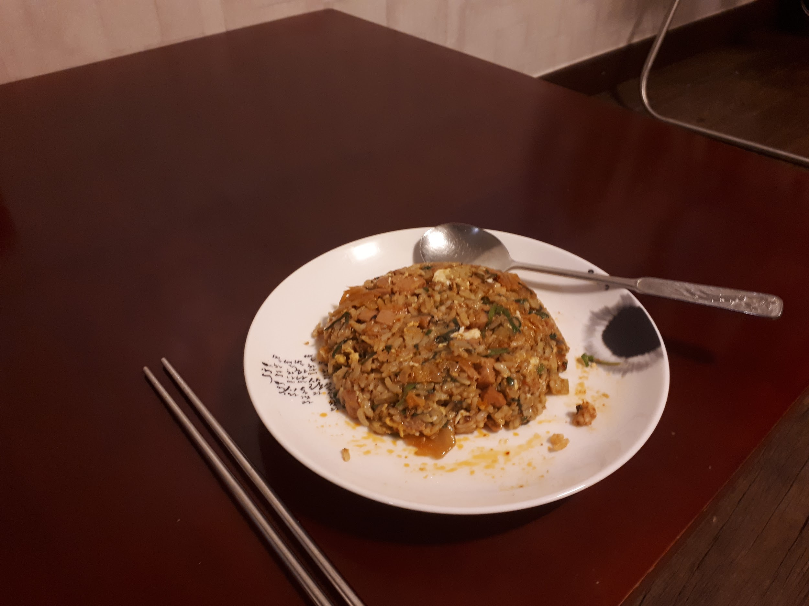
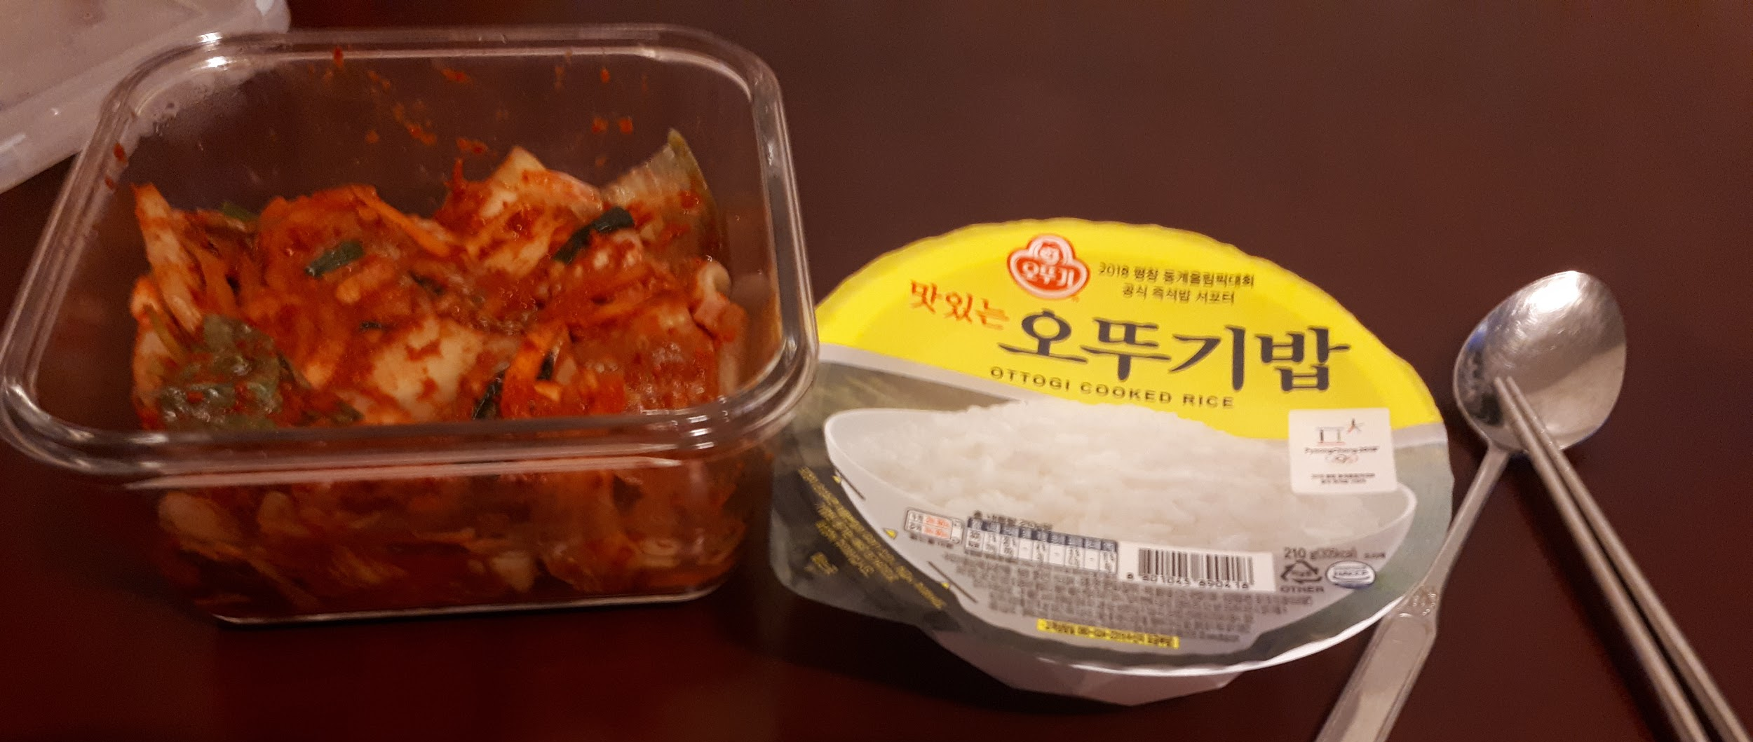
Where does olive oil used?
Pasta, Salad, for many other formal cooking
make to

Slide 3
Why we use olive oil?
Healthy
Aromatic
Universal
Notes:
It’s hard to make fragrant foods with other oil, but we can make much fragrant foods with olive oil.

Slide 4
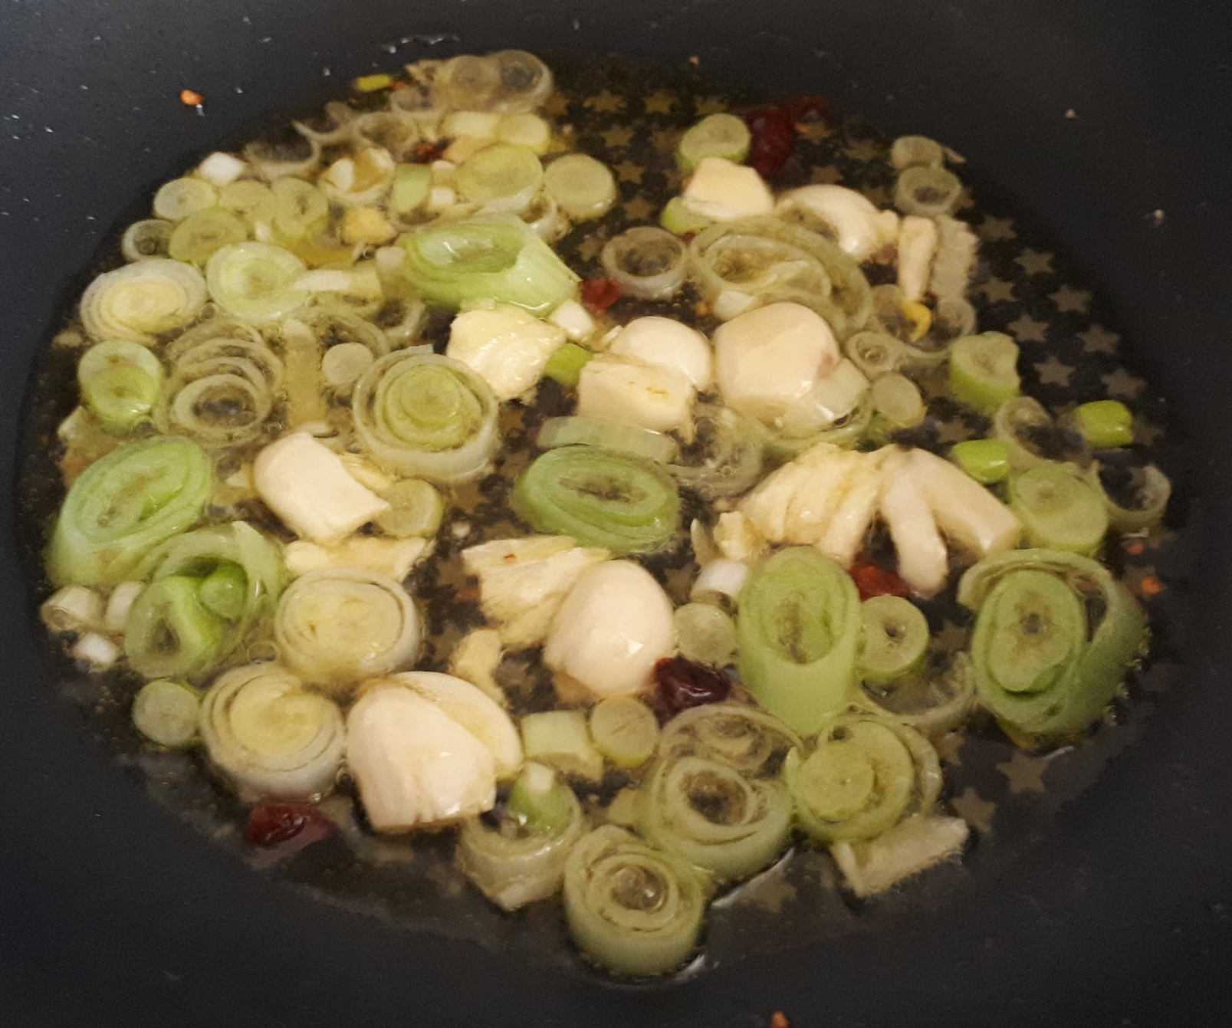
Usage for breakfast - Oil sauce
Olive oil
Scallions, onions, pepper, garlic, many kinds of spice.

Slide 5
Making Video

Slide 6
How do we use this?
Meat, chicken, beef steak, vegetables, rice, kimchi, ... anything else you want!

Slide 7
Summary
Olive oil has many benefits.
We can make olive oil sauce with other ingredient.
This sauce can be used for cooking - can put some vegetable or meat or something else

Slide 8
Thank you for Listening
Image reference:
myself

